Slide 1
Sports Facilities Provision Survey Rosedale Park

Slide 2
Rosedale Park
40 people responded about Rosedale Park (out of 192)
Of those, 6 said they never visited with 2 stating they lived too far away, 1 saying there were no facilities for them and 3 saying they were unaware of the park.
Of these people who have never visited, 2 wanted better or more varied facilities

Slide 3
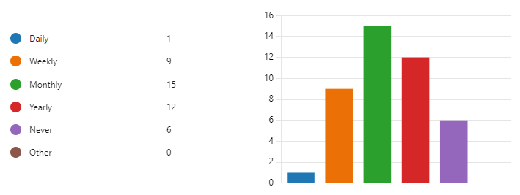
Rosedale Park
Of the 34 who do visit the park, most (15) visit on a monthly basis, followed by 13 visiting yearly.
The one person who selected ‘other’ commented “I used to play tennis every week before they were included”.
Age categories of visitors:
Under 18 | 0
18-24 | 1
25-34 | 5
35-44 | 14
45-54 | 6
55-64 | 7
65 and over | 4
How often do you visit Rosedale Park?

Slide 4
Rosedale Park
How do you usually travel to Rosedale Park?
A higher number of visitors to Rosedale Park walk.
The ‘other’ comments were both “run”.
What do you use Rosedale Park for?
People were allowed to select multiple answers for this question. Personal Leisure was the most popular answer, followed by use of play equipment.

Slide 5
Rosedale Park
What is your favourite part about Rosedale Park?
People were welcome to submit multiple answers to this question.
Location came out as the top response with 51% followed by Play Equipment with 26%.
The least popular response was to Sports Facilities with 4%.

Slide 6
Rosedale Park
What could be improved at Rosedale Park?
Sports Facilities was the highest priority, followed by General Facilities.
‘Other’ received 4 responses. These included:
“a tennis court”
“bins”
“climbing frames”
“better football area”

Slide 7
Rosedale Park
Use of existing facilities
Equipment | Frequency of Use |  | Amount of Use (4 weeks)
Play Area | Daily | 0 | 31 times
 | More than once a week | 1 (3.2%)
 | Weekly | 1 (3.2%)
 | More than twice a month | 3 (9.7%)
 | Monthly | 13 (41.9%)
 | Never | 13 (41.9%)
Football Pitches | Daily | 2 (6.9%) | 63 times
 | More than once a week | 0
 | Weekly | 0
 | More than twice a month | 1 (3.4%)
 | Monthly | 5 (17.2%)
 | Never | 21 (72.4%)
As part of the survey, people were asked to give a guide on how often they used these (i.e. daily, more than once a week, weekly, more than twice a month, monthly, never).
The play area proves to be the most used facility in Rosedale Park.
‘Amount of Use’ is calculated based on a four-week cycle based on the frequency of use (i.e. one vote for ‘daily’ equates to 28 uses in a month and a vote for ‘more than once a week’ equates to 8 uses etc.)

Slide 8
Rosedale Park
Opinion on new facilities
People were asked for their opinion on some example facilities to install in Rosedale Park and how often they would use them (i.e. daily, more than once a week, weekly, more than twice a month, monthly, never).
Equipment | Opinion
Adult Gym Equipment | Strongly Agree | 6 (17.6%)
 | Agree | 16 (47.1%)
 | Neutral | 9 (26.5%)
 | Disagree | 3 (8.8%)
 | Strongly Disagree | 0
Teenage Assault Course | Strongly Agree | 12 (38.7%)
 | Agree | 11 (35.5%)
 | Neutral | 6 (19.4%)
 | Disagree | 2 (6.5%)
 | Strongly Disagree | 0
Wheelchair Accessible Equipment | Strongly Agree | 7 (21.4%)
 | Agree | 16 (53.6%)
 | Neutral | 7 (21.4%)
 | Disagree | 1 (3.6%)
 | Strongly Disagree | 0
Equipment | Opinion
Multi-Use Sports Facility | Strongly Agree | 11 (35.5%)
 | Agree | 13 (41.9%)
 | Neutral | 6 (19.4%)
 | Disagree | 1 (3.2%)
 | Strongly Disagree | 0
Basketball Court | Strongly Agree | 8 (28.6%)
 | Agree | 8 (28.6%)
 | Neutral | 8 (28.6%)
 | Disagree | 3 (10.7%)
 | Strongly Disagree | 1 (3.6%)
Skate Park | Strongly Agree | 9 (32.1%)
 | Agree | 8 (28.6%)
 | Neutral | 7 (25%)
 | Disagree | 3 (10.7%)
 | Strongly Disagree | 1 (3.6%)

Slide 9
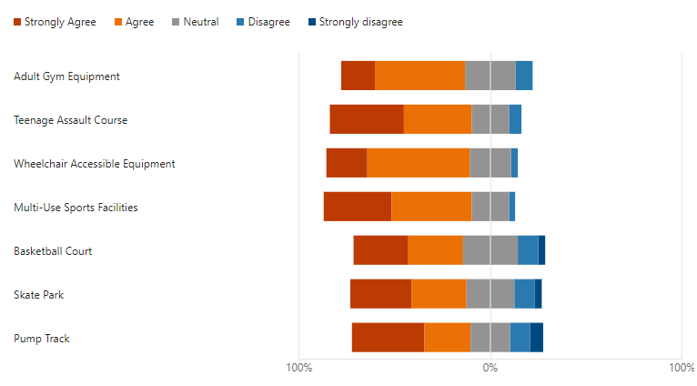
Rosedale Park
Opinion on new facilities (continued)
People were asked for their opinion on some example facilities to install in Rosedale Park and how often they would use them (i.e. daily, more than once a week, weekly, more than twice a month, monthly, never).
Equipment | Opinion
Pump Track | Strongly Agree | 11 (37.9%)
 | Agree | 7 (24.1%)
 | Neutral | 6 (20.7%)
 | Disagree | 3 (10.3%)
 | Strongly Disagree | 2 (6.9%)
From the response to people’s opinion on the example facilities, all the facilities had a positive response.
The Multi-Use Sports Facilities would prove to be the most popular facility, followed by the Wheelchair Accessible Equipment.

Slide 10
Rosedale Park
Use of new facilities
‘Amount of Use’ is calculated based on a four-week cycle based on the frequency of use (i.e. one vote for ‘daily’ equates to 28 uses in a month and a vote for ‘more than once a week’ equates to 8 uses etc.)
Equipment | Frequency of Use |  | Amount of Use (4 weeks)
Adult Gym Equipment | Daily | 2 (6.9%) | 107 times
 | More than once a week | 3 (10.3%)
 | Weekly | 4 (13.8%)
 | More than twice a month | 2 (6.9%)
 | Monthly | 7 (24.1%)
 | Never | 9 (37.9%)
Teenage Assault Course | Daily | 1 (3.6%) | 67 times
 | More than once a week | 3 (10.7%)
 | Weekly | 1 (3.6%)
 | More than twice a month | 3 (10.7%)
 | Monthly | 5 (17.9%)
 | Never | 15 (53.6%)
Wheelchair Accessible Equipment | Daily | 2 (7.7%) | 61 times
 | More than once a week | 0
 | Weekly | 0
 | More than twice a month | 0
 | Monthly | 5 (19.2%)
 | Never | 19 (73.1%)
Equipment | Frequency of Use |  | Amount of Use (4 weeks)
Multi-Use Sports Facilities | Daily | 3 (11.1%) | 123 times
 | More than once a week | 2 (7.4%)
 | Weekly | 1 (3.7%)
 | More than twice a month | 4 (14.8%)
 | Monthly | 11 (40.7%)
 | Never | 6 (22.2%)
Basketball Courts | Daily | 2 (7.4%) | 77 times
 | More than once a week | 1 (3.7%)
 | Weekly | 0
 | More than twice a month | 3 (11.1%)
 | Monthly | 7 (25.9%)
 | Never | 11 (51.9%)
Skate Park | Daily | 2 (7.4%) | 85 times
 | More than once a week | 2 (7.4%)
 | Weekly | 2 (7.4%)
 | More than twice a month | 1 (3.7%)
 | Monthly | 3 (11.1%)
 | Never | 17 (63%)

Slide 11
Rosedale Park
Equipment | Frequency of Use |  | Amount of Use (4 weeks)
Pump Track | Daily | 2 (7.1%) | 94 times
 | More than once a week | 2 (7.1%)
 | Weekly | 3 (10.7%)
 | More than twice a month | 3 (10.7%)
 | Monthly | 4 (14.3%)
 | Never | 14 (50%)
Use of new facilities (continued)
‘Amount of Use’ is calculated based on a four-week cycle based on the frequency of use (i.e. one vote for ‘daily’ equates to 28 uses in a month and a vote for ‘more than once a week’ equates to 8 uses etc.)
In summary, the Multi-Use Sports Facility would have the most uses in a four-week cycle (123), followed by the Adult Gym Equipment.
The Wheelchair Accessible Equipment would receive the least uses.

Slide 12
Rosedale Park
New facilities
People also offered a range of comments on other new facilities or improvements they would like to see. These include:
Better football pitches for the kids
Football goals with nets
Potential of a running track
Tennis Courts x2
Café
Planting, varied ability to walk/run in wildlife
Facilities for older children and young adults
Zip line added to the park area

Slide 13
Rosedale Park
Accessibility and Inclusion
People were offered a chance to leave comments on how Rosedale Park could be more accessible and inclusive.
Only two comments were left in this section.
definitely more sports facilities as there are big housing estates nearby -people need exercise
No parking nearby, creating a parking layby may take up some space, but create more use.

Slide 14
Rosedale Park
Additional Comments
People were asked to also submit any additional comments about the park. Only one comment was left for this area
“The play oak equipment is not much good”

