Slide 1
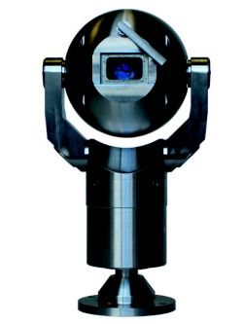
CCTV IN WAVENEY
Overview of Service

Slide 2
Background
The creation of a CCTV service in Waveney started in 1998 after a successful bid by Waveney District Council to the Home Office following detailed discussions with interested parties, including Suffolk Constabulary.
Working in Partnership with Suffolk Constabulary the locations of historical crime and anti social behaviour were identified and this is where the first 17 cameras were installed.

Slide 3
Change of Operator
In 2011 the entire CCTV service was transferred from Waveney District Council to Waveney Norse as agreed via the Joint Venture Partnership arrangement.
Waveney Norse currently monitors all the cameras.

Slide 4
Additional Cameras
Between 1999 and 2017 an additional 47 cameras were installed throughout Lowestoft including those at the Council Depot at Rotterdam Road.
Funding for these cameras was met from a number of sources:
Waveney District Council Capital Programme Budget
Suffolk County Council
The Pathfinder Project
The Poor Areas Trust
Section 106
To name a few.

Slide 5
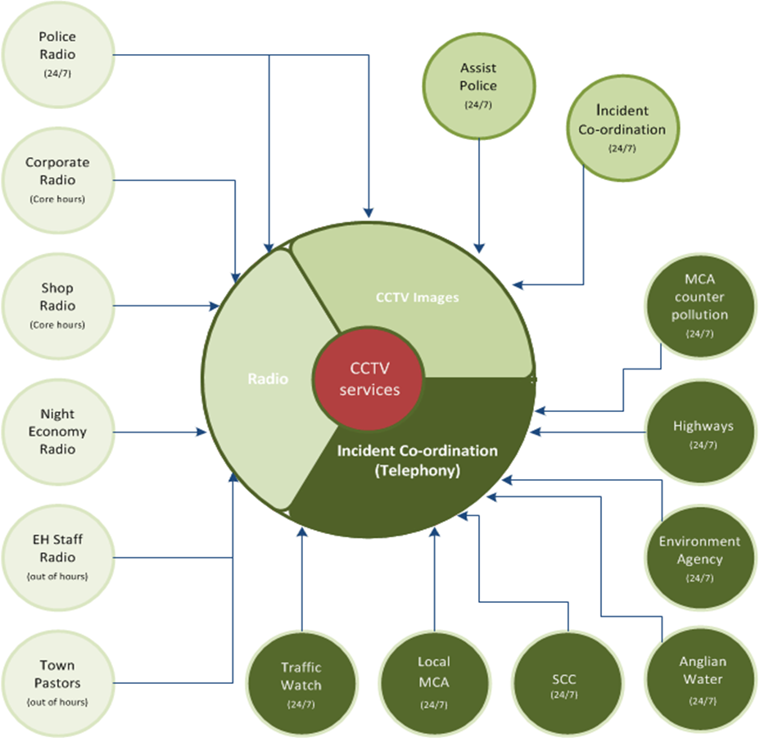
CCTV Function/Services Provided
24/7 Police/community safety assistance and incident evidence resource
24/7 multi-agency incident co-ordination and assistance
SCDC/WDC SCN/WN corporate radio and lone worker protection
Out of hours point of contact for call outs for SCDC/WDC
Out of hours point for contact for night time economy, Town Pastors and Council staff.
Emergency response, business continuity, Civil Contingencies Act and Major Incident Plan

Slide 6
On-going Maintenance
The majority of the funding is one off funding from external bodies leaving the management company to pick up the ongoing running, maintenance and replacement costs, with little scope for new external money to support this in the current economic climate.

Slide 7
Monitoring
The CCTV Suite is monitored 24 hours a day, 365 days a year.
Staff must be competent, fully trained approved operators. They must meet Norfolk and Suffolk Constabulary Police vetting standards criteria and agree to comply with the vetting protocol.
There are currently 5 full time equivalent staff plus casual staff who work to a 6 day rota which includes 2 early shifts, 2 late shifts and 2 night shifts.

Slide 8
Duties
Monitoring of CCTV cameras and completion of all necessary logs during the course of a shift
Locate images, instruct and assist Police Officers on the review desk ensuring all associated paperwork is completed and procedures complied with
Monitoring the safety of lone workers via radio and telephone
Monitoring the shop radio scheme for the town centre, users of Nightsafe and the Town Pastors
Seasonal and ad hoc monitoring of Environmental Health Officers
Separate Police radio system which creates a direct link between the Police control room and the CCTV operator, or direct point to point conversation with a Police Officer. The Police will regularly update CCTV regarding recent incidents, missing persons and persons of interest to name a few. CCTV can contact the Police in an emergency or to update them on a specific incident.
First point of contact for major incidents/emergencies in accordance with the Councils Major Incident Plan in order to comply with the Civil Contingencies Act.
Acting as a focal point for communications with other agencies and members of the public.
Providing information and assistance to members of the public out of hours; including contacting other agencies to report e.g. street lights out, lost/found dogs, blocked drains etc

Slide 9
Out of Hours Statistics 2017
2017
Out of Hours Calls: | Jan | Feb | Mar | Apr | May | Jun | Jul | Aug | Sep | Oct | Nov | Dec | Total
Barrier Requests | 2 | 6 | 5 | 31 | 29 | 64 | 80 | 13 | 0 | 0 | 0 | 2 | 232
Bus Shelters | 4 | 0 | 0 | 0 | 0 | 1 | 0 | 0 | 0 | 1 | 0 | 6 | 12
Car Parks | 14 | 15 | 0 | 31 | 7 | 12 | 5 | 14 | 5 | 5 | 2 | 0 | 110
Caravan/Camp Sites | 0 | 0 | 12 | 0 | 0 | 1 | 0 | 0 | 1 | 1 | 0 | 8 | 23
Cleansing | 1 | 4 | 0 | 5 | 1 | 4 | 6 | 10 | 5 | 4 | 1 | 0 | 41
Coastal Oil Pollution | 0 | 0 | 7 | 0 | 0 | 0 | 0 | 0 | 0 | 0 | 0 | 0 | 7
Corporate Property | 6 | 4 | 1 | 4 | 6 | 5 | 6 | 6 | 5 | 4 | 8 | 2 | 57
Dangerous Structures | 0 | 0 | 3 | 2 | 1 | 0 | 1 | 0 | 0 | 0 | 0 | 2 | 9
Dead Animals | 0 | 2 | 2 | 3 | 2 | 5 | 0 | 0 | 0 | 2 | 1 | 24 | 41
Drainage & Pumping | 0 | 6 | 0 | 4 | 0 | 0 | 4 | 7 | 2 | 1 | 1 | 0 | 25
Environmental Health | 3 | 1 | 0 | 2 | 3 | 0 | 1 | 1 | 2 | 0 | 0 | 3 | 16
Flood Warnings | 116 | 0 | 0 | 0 | 0 | 2 | 0 | 0 | 2 | 34 | 6 | 0 | 160
Flooding - Private | 14 | 0 | 0 | 0 | 0 | 0 | 0 | 0 | 0 | 0 | 0 | 1 | 15
Highways | 0 | 2 | 1 | 1 | 4 | 1 | 2 | 3 | 0 | 1 | 1 | 0 | 16
Highways Electrical | 0 | 1 | 2 | 0 | 0 | 2 | 0 | 0 | 0 | 0 | 0 | 38 | 43
Homelessness | 0 | 5 | 0 | 5 | 1 | 4 | 2 | 4 | 1 | 2 | 3 | 0 | 27
Major Incidents | 1 | 0 | 0 | 0 | 1 | 0 | 0 | 0 | 0 | 0 | 0 | 0 | 2
Misdirected Calls | 5 | 16 | 1 | 32 | 26 | 29 | 3 | 33 | 23 | 7 | 12 | 0 | 187
Play Areas | 0 | 0 | 0 | 0 | 2 | 1 | 0 | 0 | 0 | 0 | 0 | 0 | 3
Potholes/Defects in Highway | 0 | 0 | 1 | 2 | 1 | 0 | 2 | 0 | 0 | 0 | 0 | 3 | 9
Public Sewers | 0 | 0 | 6 | 1 | 0 | 0 | 0 | 0 | 0 | 0 | 0 | 1 | 8
Removals of Debris/Vehicles | 4 | 1 | 4 | 1 | 3 | 1 | 2 | 1 | 2 | 5 | 0 | 0 | 24
Stray/Found Dogs | 16 | 8 | 0 | 8 | 6 | 2 | 13 | 13 | 5 | 4 | 4 | 0 | 79
Toilets | 2 | 6 | 0 | 8 | 4 | 11 | 8 | 11 | 6 | 5 | 2 | 1 | 64
Traffic Signals | 1 | 0 | 0 | 0 | 0 | 0 | 1 | 0 | 0 | 0 | 0 | 0 | 2
Travellers | 0 | 0 | 0 | 4 | 3 | 0 | 1 | 0 | 1 | 0 | 0 | 0 | 9
Trees/Grounds | 1 | 2 | 17 | 1 | 4 | 2 | 1 | 0 | 1 | 2 | 0 | 0 | 31
Winter Maintenance | 1 | 0 | 18 | 0 | 0 | 0 | 0 | 0 | 0 | 0 | 0 | 0 | 19
Others | 6 | 0 | 0 | 1 | 1 | 4 | 3 | 1 | 0 | 4 | 5 | 0 | 25
Total | 197 | 79 | 80 | 146 | 105 | 151 | 141 | 117 | 61 | 82 | 46 | 91 | 1296

Slide 10
Police Incidents
 | Month
Incidents and Requests: | 1 | 2 | 3 | 4 | 5 | 6 | 7 | 8 | 9 | 10 | 11 | 12 | Total
ABH | 0 | 1 | 0 | 0 | 0 | 0 | 0 | 2 | 0 | 0 | 0 | 0 | 3
Affray | 3 | 1 | 0 | 1 | 0 | 0 | 0 | 1 | 1 | 1 | 0 | 1 | 9
Antisocial behaviour | 6 | 4 | 6 | 7 | 16 | 6 | 3 | 8 | 1 | 2 | 5 | 7 | 71
Arson | 1 | 1 | 0 | 0 | 2 | 0 | 1 | 2 | 0 | 1 | 1 | 0 | 9
Assault | 5 | 10 | 5 | 7 | 4 | 8 | 12 | 4 | 6 | 5 | 5 | 9 | 80
Begging | 4 | 0 | 0 | 0 | 0 | 0 | 1 | 0 | 5 | 0 | 1 | 2 | 13
Breach of order | 0 | 2 | 0 | 0 | 4 | 1 | 0 | 0 | 0 | 2 | 0 | 1 | 10
Burglary | 2 | 2 | 6 | 1 | 2 | 1 | 2 | 3 | 2 | 6 | 3 | 3 | 33
Criminal damage | 3 | 4 | 5 | 3 | 1 | 1 | 1 | 6 | 2 | 11 | 1 | 2 | 40
Drug related | 2 | 4 | 1 | 6 | 1 | 3 | 1 | 1 | 2 | 0 | 1 | 1 | 23
Drunk and disorderly | 4 | 3 | 5 | 10 | 6 | 9 | 4 | 12 | 6 | 2 | 2 | 6 | 69
GBH | 2 | 0 | 0 | 0 | 0 | 0 | 2 | 0 | 0 | 1 | 0 | 0 | 5
Mispers | 45 | 18 | 14 | 26 | 26 | 34 | 30 | 13 | 25 | 25 | 29 | 18 | 303
Public order offences | 10 | 12 | 12 | 17 | 14 | 22 | 13 | 12 | 9 | 10 | 9 | 20 | 160
RTC | 1 | 0 | 0 | 1 | 2 | 2 | 4 | 6 | 4 | 2 | 5 | 1 | 28
Sexual assault | 0 | 0 | 1 | 0 | 0 | 0 | 0 | 1 | 1 | 0 | 1 | 2 | 6
Street drinking | 2 | 1 | 0 | 1 | 0 | 1 | 4 | 1 | 2 | 0 | 1 | 3 | 16
Suicide related | 2 | 4 | 3 | 4 | 3 | 3 | 4 | 5 | 3 | 2 | 4 | 4 | 41
Theft | 16 | 17 | 16 | 18 | 22 | 21 | 13 | 32 | 24 | 28 | 29 | 19 | 255
Vulnerable persons | 4 | 1 | 1 | 3 | 8 | 8 | 1 | 3 | 1 | 4 | 2 | 5 | 41
Wanted persons | 12 | 9 | 10 | 13 | 1 | 10 | 14 | 5 | 10 | 9 | 7 | 11 | 111
Welfare checks | 5 | 1 | 4 | 1 | 6 | 2 | 3 | 4 | 2 | 4 | 2 | 3 | 37
Others | 15 | 10 | 11 | 5 | 6 | 11 | 11 | 11 | 21 | 12 | 9 | 8 | 130
Total | 144 | 105 | 100 | 124 | 124 | 143 | 124 | 132 | 127 | 127 | 117 | 126 | 1493

Slide 11
Map of Camera Locations

Slide 12
List of Camera Locations
Cameras 1 – 6, 19, and 41 London Road South
Cameras 7 – 12 London Road South
Camera 13 Battery Green Road
Camera 14 Clapham Road Car Park
Camera 15 Bridge Road
Camera 16 Bevan Street
Camera 17 Pier Terrace
Camera 18 The Boulevard
Camera 20 Fen Park
Cameras 21- 23 High Street
Camera 24 Whitton Green
Camera 25 Hollingsworth Road Shops
Camera 26 Montgomery Avenue Play Area
Camera 27 East Point Pavilion
Camera 28 – 32 Linear Park
Cameras 33 – 37 Upper Promenade Car Parks and South Pier
Camera 38 Victoria Terrace
Camera 39 Clifton Road Car Park
Camera 40 Vacant Slot
Cameras 42 -44 Lower Promenade
Cameras 45 – 47 and 52 – 61 Depot
Cameras 48 – 51 Water Lane
Cameras 62 and 63 Corton

Slide 13
Condition Survey
There are currently 62 cameras currently monitored by the CCTV Operators.
Of these, not including the Depot in Rotterdam Road or Water Lane Sports Centre, the quality of the cameras, in percentage terms, would be described as:
7% PERFECT
49% GOOD
33% LIMITED USE, REQUIRE REPLACEMENT
11% NOT IN USE, REQUIRE REPLACEMENT

Slide 14
ANY QUESTIONS?

