Slide 1
Lowestoft Town Hall Project
Progress Update to Annual Assembly
26 May 2022
Sheila King
MossKing Associates

Slide 2
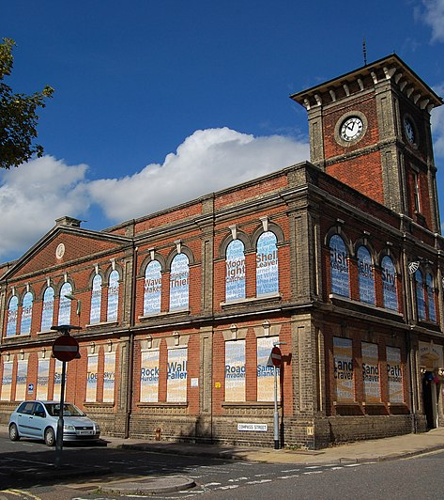
Topics
Where we’re up to…. and what’s happening from now
What will be included in the Town Hall
Design work
Heritage activities
Timescales
Questions?
Photo: Sirpecangum/CC-BY-SA 4.0

Slide 3
Where we’re up to
2021 – submitted a funding application to the National Lottery Heritage Fund. A two stage process: development then delivery
March 2022 – project manager appointed
May 2022 – appointed the design team and our heritage project manager
Focus now: detailed work to create a Stage 2 bid for delivery funding
Key message: grant funded projects take a long time…
but if you’re successful, people give you money!

Slide 4
What will be in the Town Hall?
Survey in 2021, completed by 999 residents – statistically reliable
Over 90% from NR32, NR33 postcodes
We asked
what you would like to see the Town Hall used for
how much you’d use facilities
history you would be interested in

Slide 5
Partial/temporary use of space
Included in design brief

Slide 6
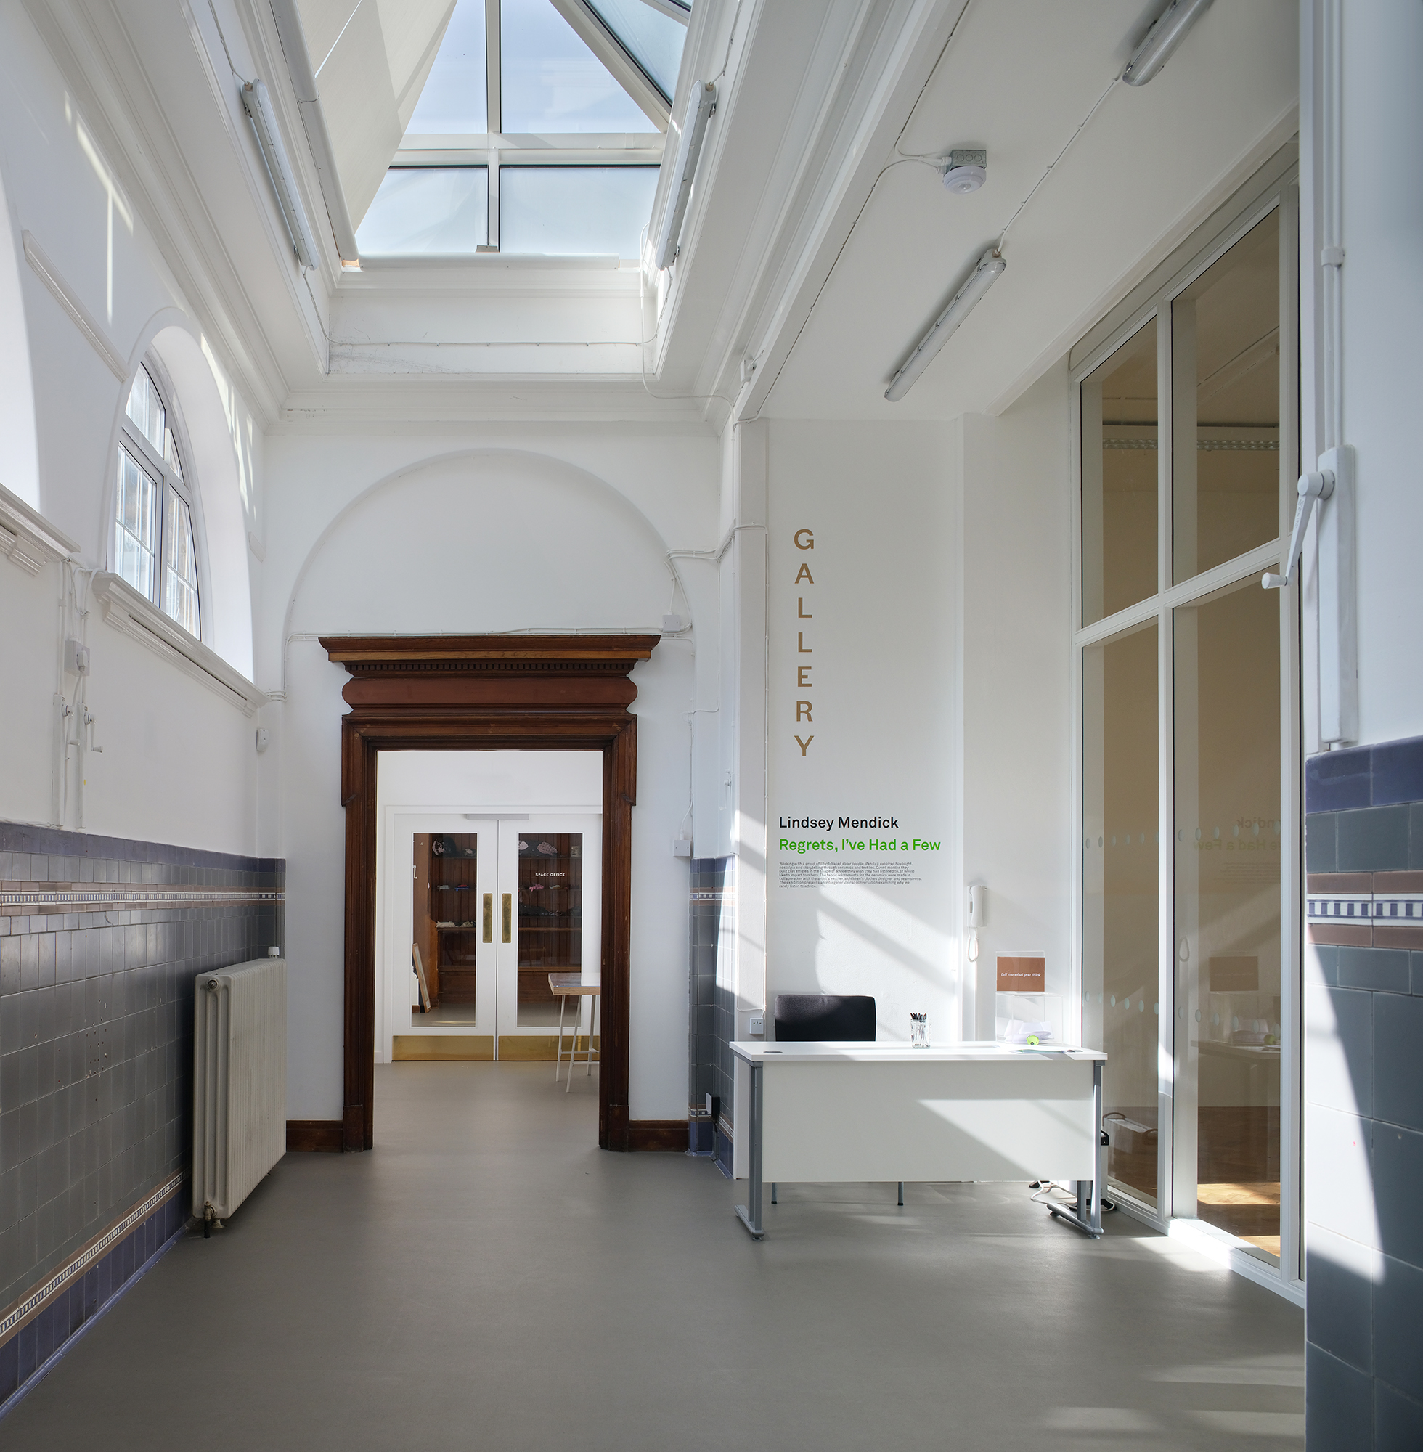
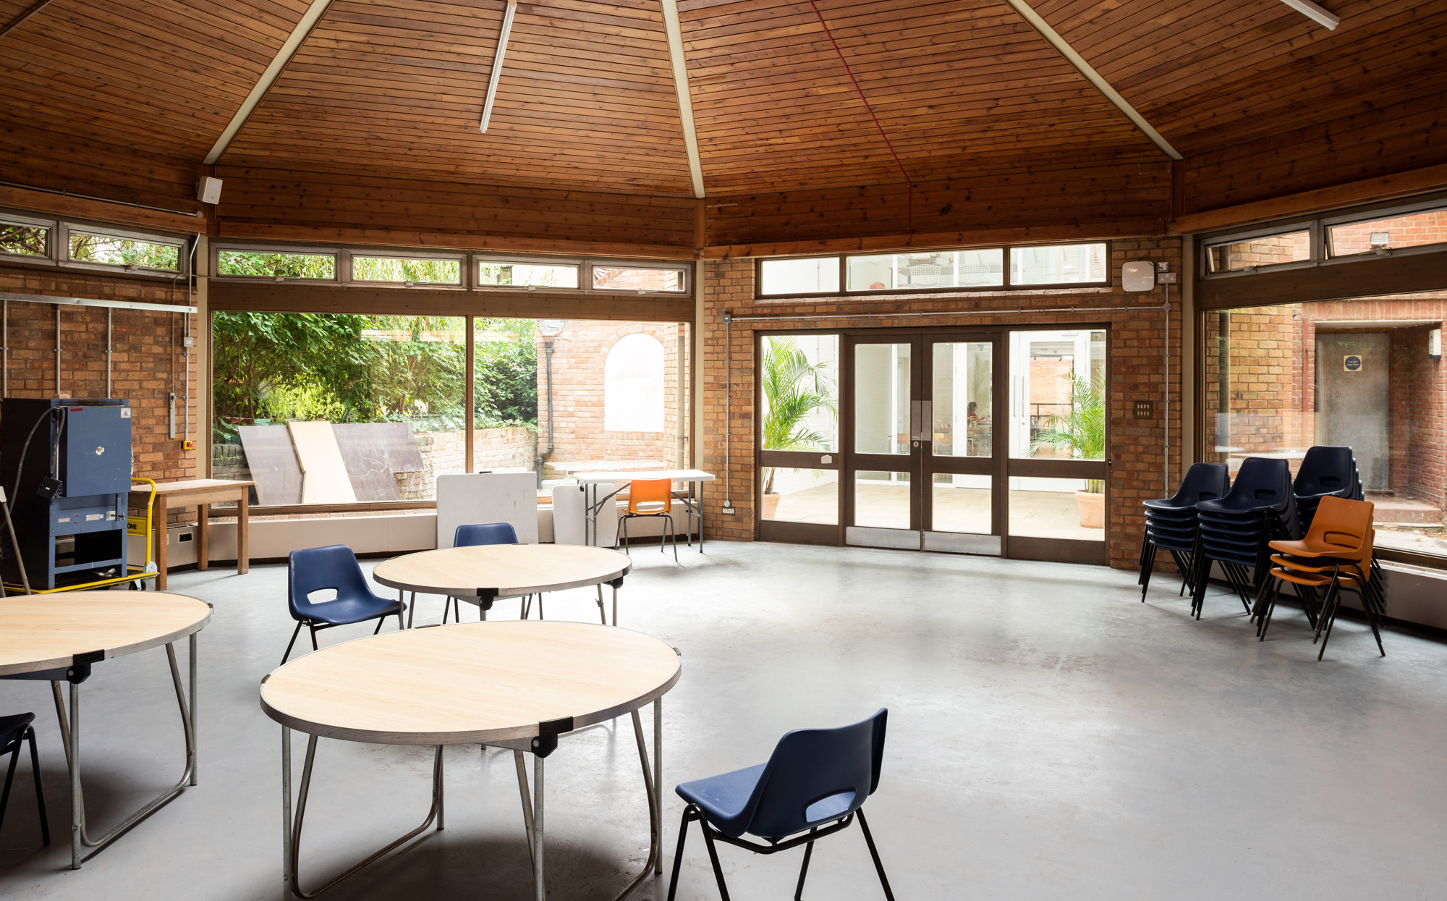
Design work
HAT Projects from Colchester won the design team tender this month
Designs will be developed to apply for planning and listed building consent
Public consultation on the designs will happen as part of that process

Slide 7
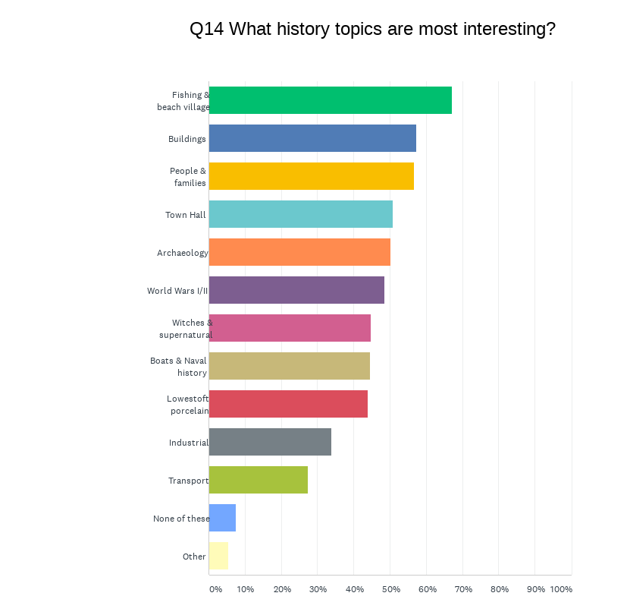
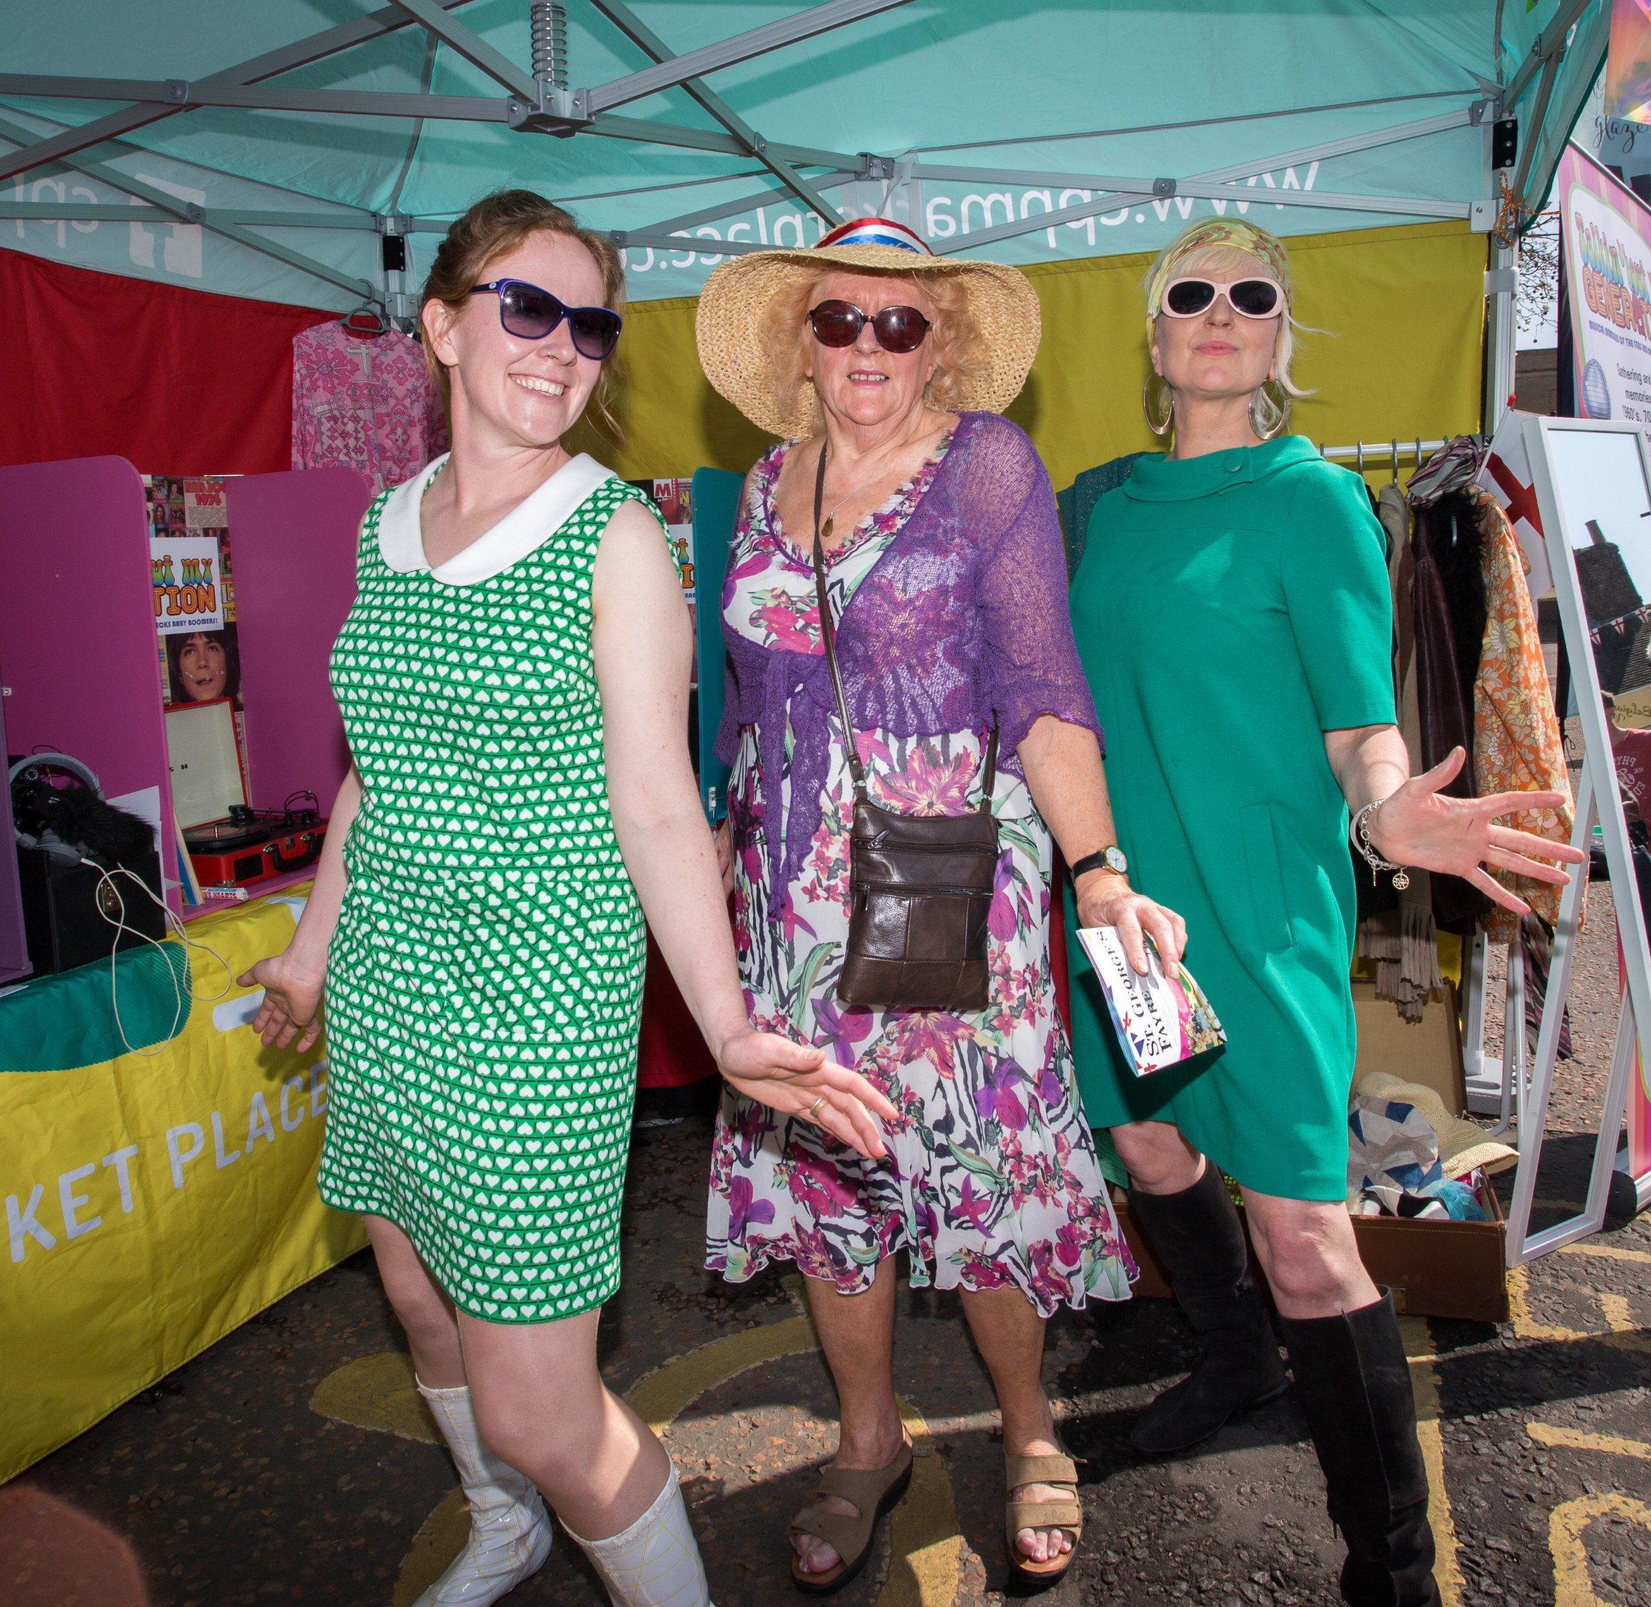
Heritage activities
Over the next 9 months, residents’ opportunity to get involved
Pilot activities focus on recent history: the Town Hall & industry/work in Lowestoft
Stories Boat to capture memories
Work with Poetry People
‘Town Hall Takeovers’
Work with town’s museums & historians
Plus, designing the museum…

Slide 8
Timescales
This stage runs to Spring 2023 when we’ll apply to NLHF for rest of funding
IF all goes according to plan
detailed design work starts Autumn 2023
construction work start late Spring/Summer 2024
Town Hall reopens Summer 2025

Slide 9
Questions

